Slide 1

THE MINERALS WE NEED, WHY WE NEED THEM, AND WHY IT MATTERS
The Perspective of Resource Rich Countries: the Chilean Experience
Eduardo Bitran
Professor University Adolfo Ibañez

Slide 2
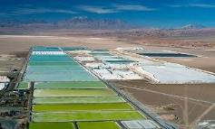
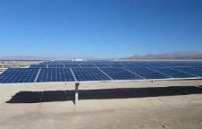
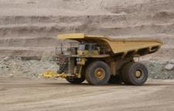
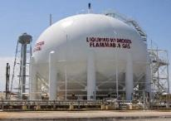
Critical Minerals: The Opportunity for Chile with the acceleration of Global Climate Action, Digital Economy(AI) and the Energy Transition
Chile: leading supplier of lithium, low-emission copper and clean fuels for the energy transition
World's largest low emission copper producer
World's leading lithium
producer
Long term sustainable growth in supply of lithium
Solar energy for continues renewable electricity supply
Responsible Mining and
Shared value creation
Fossil fuels substitution:
Green Hydrogen and Synthetic fuels

Slide 3
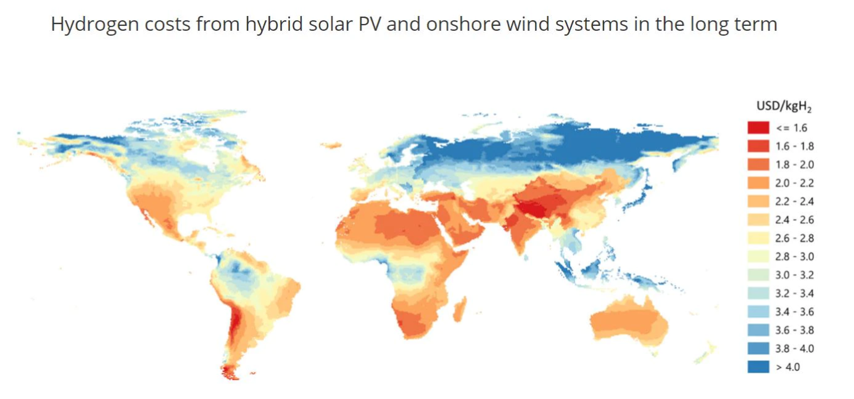
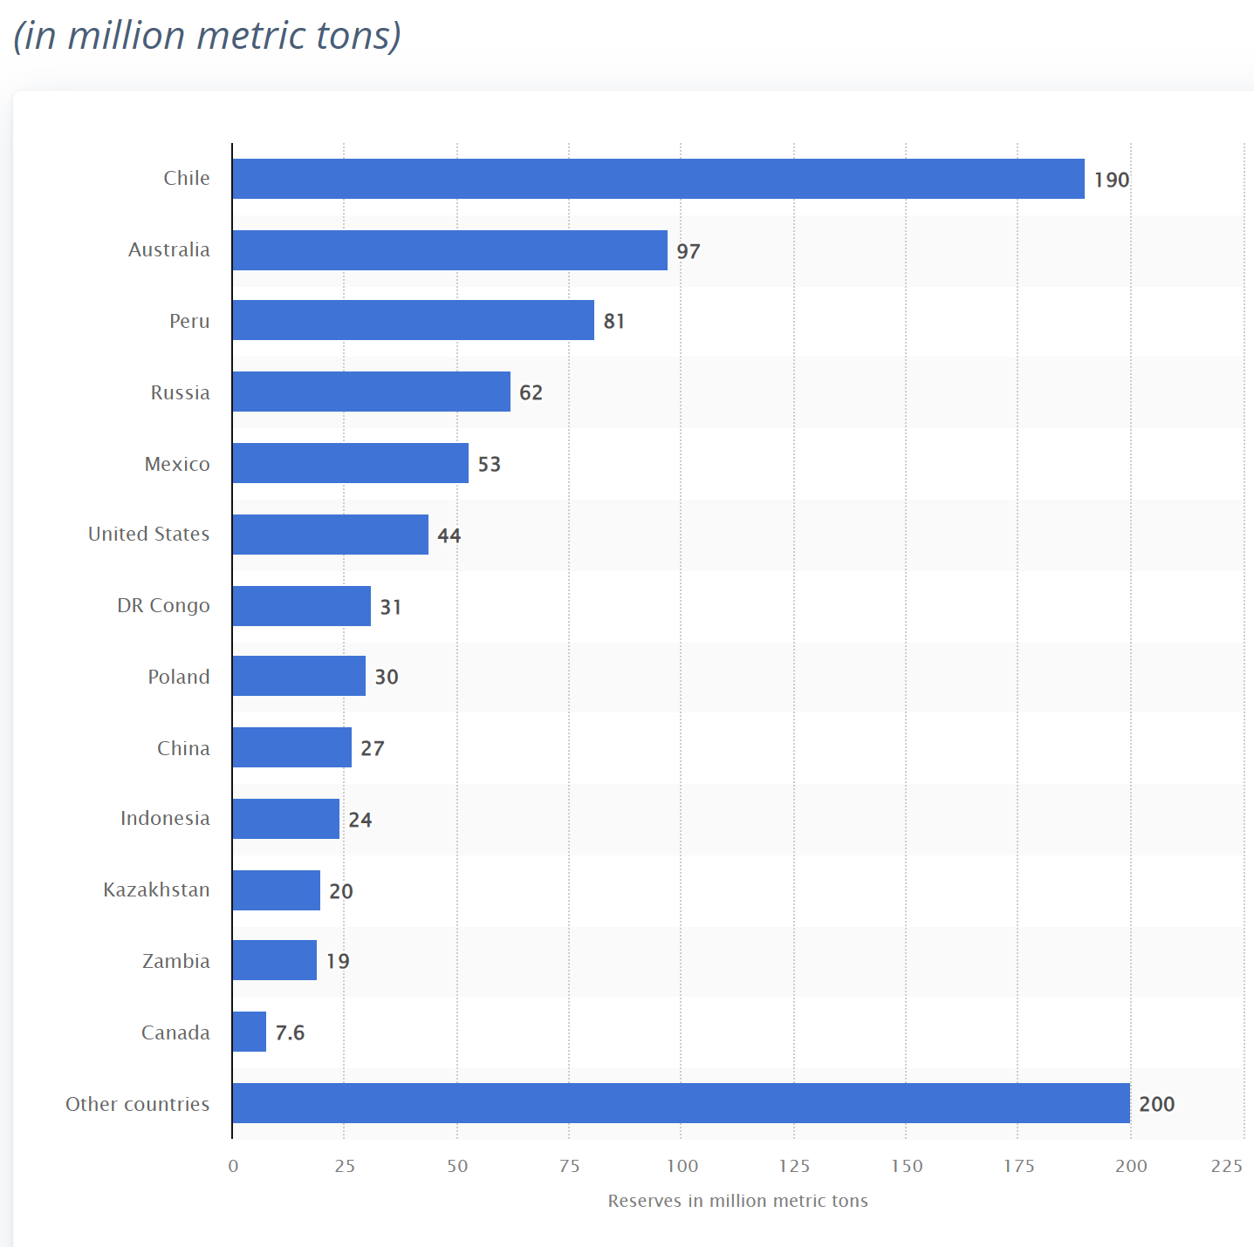
CHILE HAS OUSTANDING RENEWABLE ENERGY RESOURCES AND THE LARGEST RESERVES OF COPPER AND LITHIUM
WORLD RESERVES OF COPPER
Chile: Share of solar and wind energy in electricity supply
2011 | 0,5%
2021 | 21,4%
2022 | 28%
2023 | 37%

Slide 4
CHILE HAS OUSTANDING RENEWABLE ENERGY RESOURCES AND THE LARGEST RESERVES OF COPPER AND LITHIUM
WORLD RESERVES OF COPPER
Chile: Share of solar and wind energy in electricity supply
2011 | 0,5%
2021 | 21,4%
2022 | 28%
2023 | 37%

Slide 5
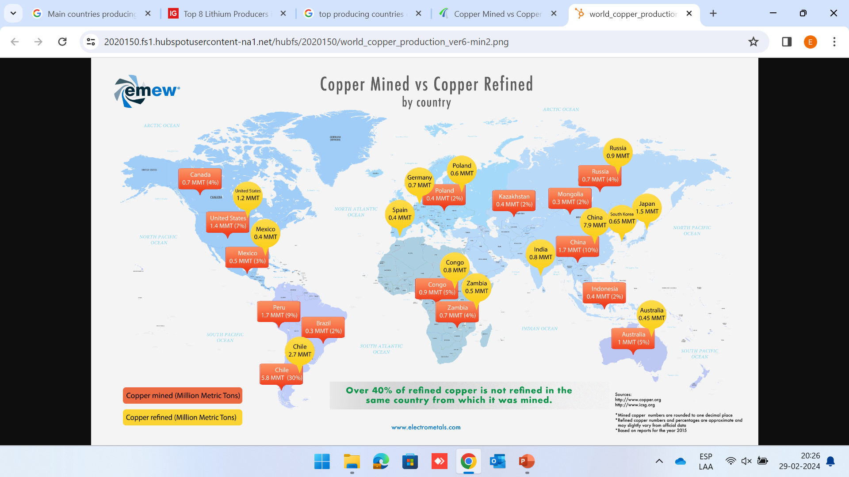
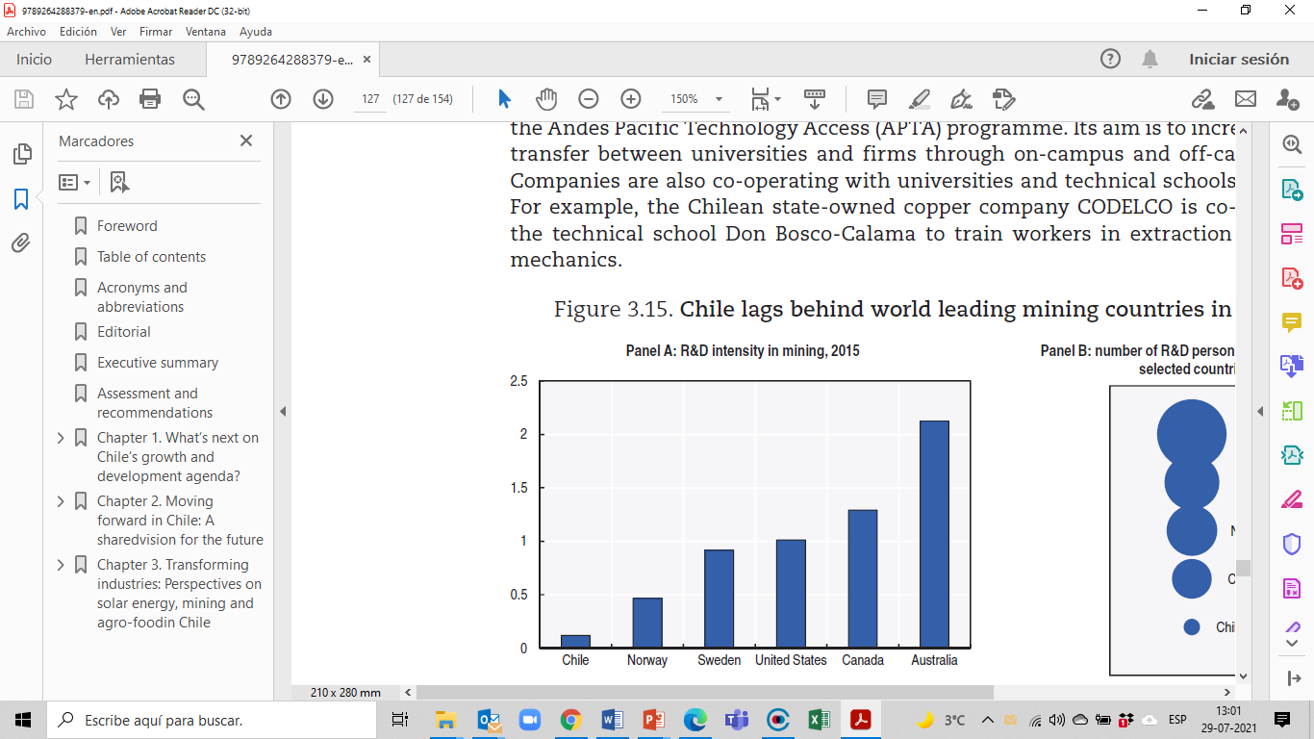
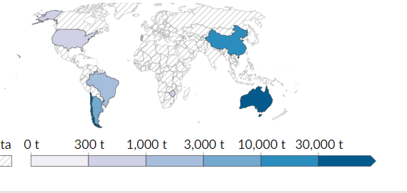
Risk of Concentrated Refined Copper and Lithium Capacity and ion-lithium battery production
Countries | Copper Mined | Copper Refined | Reserves
Chile | 28% | 14% | 21%
Perú | 9% | 0% | 9%
China | 10% | 41% | 3%
United States | 7% | 6% | 5%
Australia | 5% | 2% | 11%
Congo | 5% | 4% | 4%
Countries | Lithium Production | Refinary Production | Reserves | Battery
Chile | 26% | 29% | 36% | 0%
Australia | 47% | 0% | 24% | 0,1%
China | 17% | 65% | 8% | 79%
United States | 7% | 1% | 5% | 4%
Argentina | 5% | 5% | 10% | 0%
Battery Production Capacity
World Lithium production

Slide 6
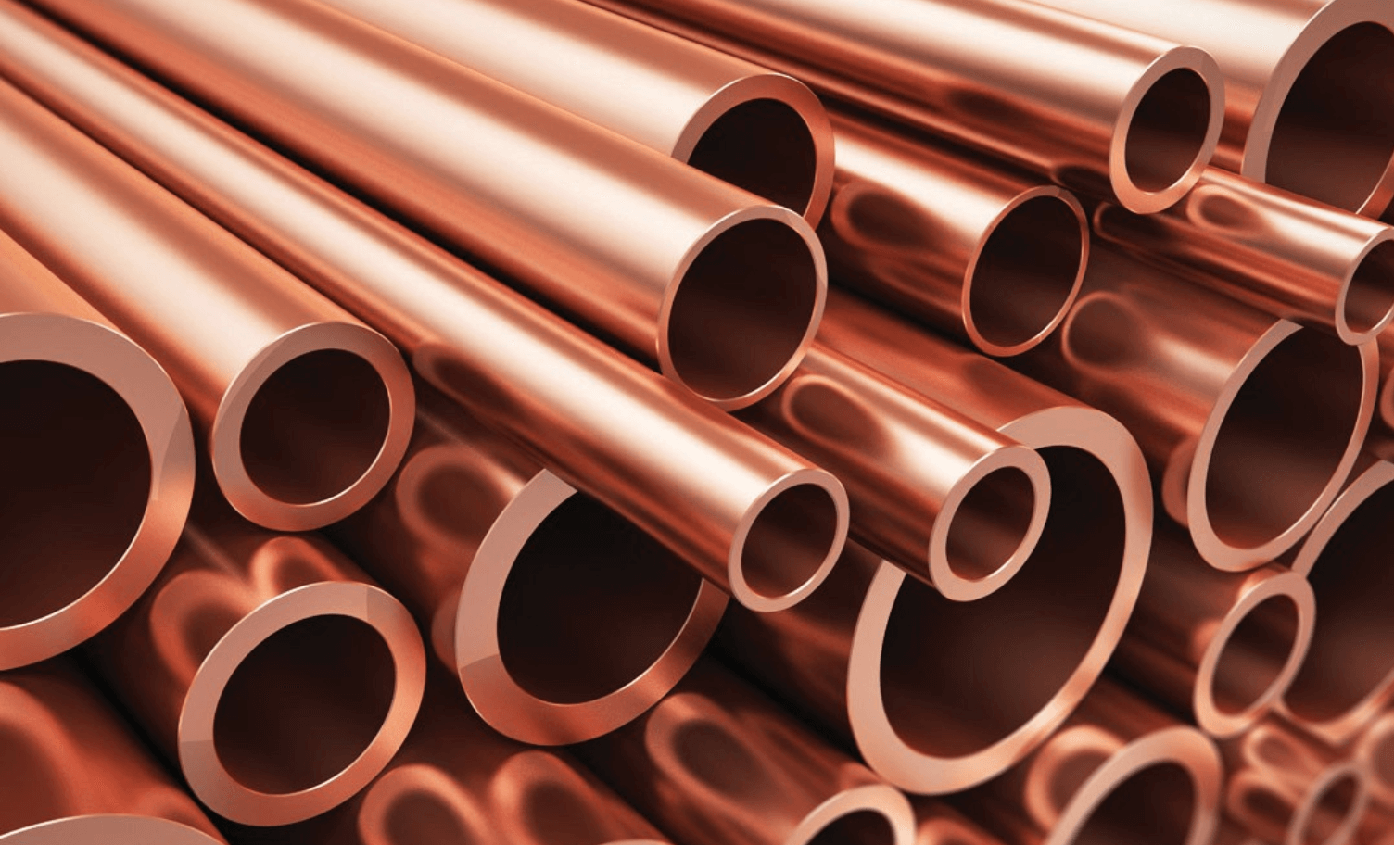
ENERGY TRANSITION AND CRITICAL MINERALS: HOW CAN CHILE MAXIMIZE THE POSITIVE IMPACT ON ITS SUSTAINABLE AND INCLUSIVE DEVELOPMENT GOALS?
1. Fiscal Revenue and Taxing Economic Rents
2. Responsible Mining and Just Socio Ecological Energy Transition
Virtuous mining and cluster development for the sophistication of Chilean economy
Leverage geopolitical factors by diversifying critical minerals demand

Slide 7
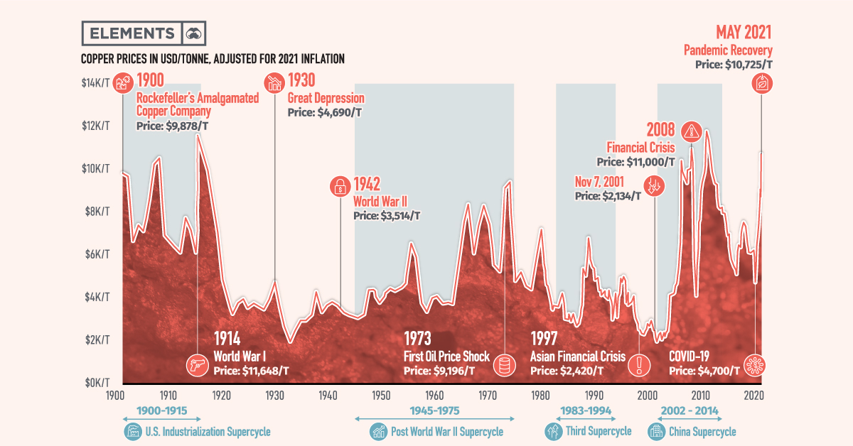
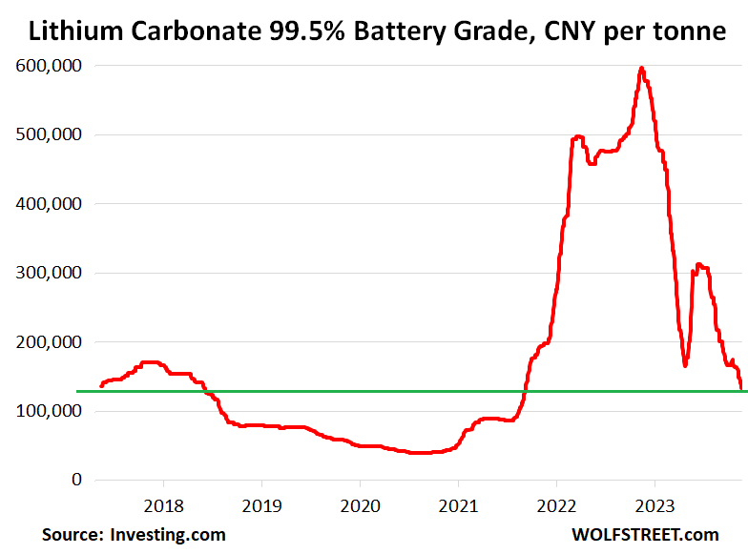
1. Fiscal Revenue and Taxing Economic Rents
Distinction between Ricardian Economic Rents and Schumpeterian Innovation Quasi Rents
Sharp price fluctuations and economic windfall rents
Copper Prices, adjusted by inflation (2021)
  Effective rate of taxation on Lithium and Copper: increasing royalty marginal rates
    Lithium 50% -65%: Fiscal revenue increased from 0,1% to 1,6% of GDP between 2021 and 2022.
    Copper 40%-46,5%(cap): Private copper operations generated fiscal revenue 2,1% of GDP in 2021
  Transfer Prices and profit Shifting:
Following OECD recommendations applying "arm's length principle”. Considers prices of non-related transactions.
  Revenue windfalls, fiscal stabilization schemes
  Fiscal expenditure based on long term prices, preventing Dutch disease effects

Slide 8
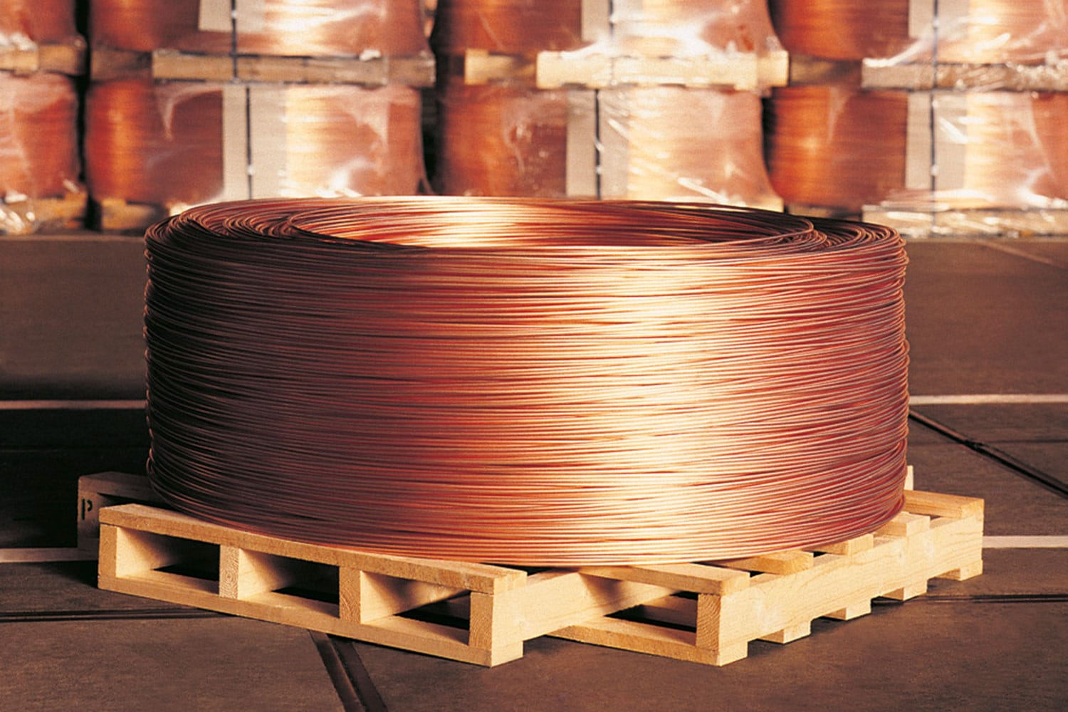
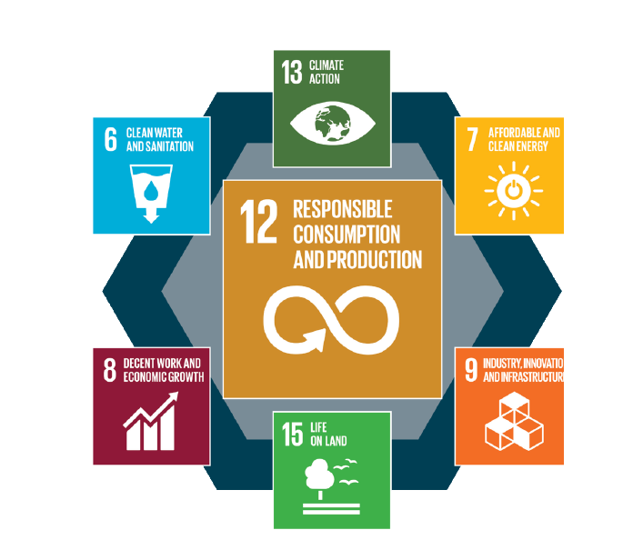
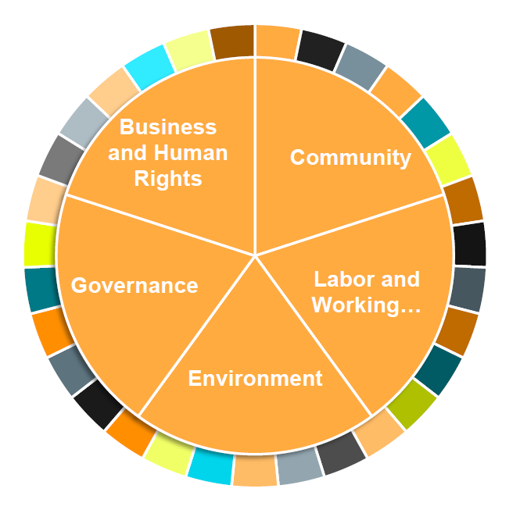
2. Responsible Mining: Supporting Climate Action, Just Socio-ecological Energy Transition and good governance
Copper Paradox
How do we increase the production … and do so by processing lower and more complex grade ores, reducing emissions and without using more energy and water, and producing less waste?
“Copper for Tomorrow”(2022). Institute for Sustainable Energy and Resources
Societal Requirements
to Mining (SDG)
Just Socio-ecological Transition: Decarbonization in a fair way.
Minimizing local environmental Impact and facilitating adaptation of vulnerable groups to climate change.
Community Engagement: creating economic value while also addressing local issues and concerns.
New Market Conditions from
Clean Energy Demand
(Certification and Traceability)

Slide 9
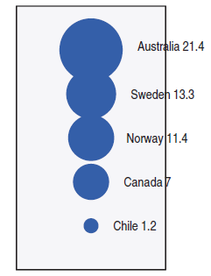
Virtuous Mining and Cluster Development for the Sophistication of
Chilean Economy (Intergenerational equity)
METS: Mining Equipment, Technology and Services
R&D Intensity
Innovation Personnel
Countries | Exports (U$ b) | Share of Mining Exports
Chile | 0,8 | 1,4%
Australia | 20 | 12,5%
Canada | 3,8 | 4,4%
Sweden | 13 | 55,7%
Main Obstacles
Virtuous Mining for long term economic development of territories
Underdeveloped Innovation Ecosystem.
Very Low Innovation of Mining Co. in Chile
Lack of skilled labor.
FDI maintaining R&D in country of origin
US IRA and European “Green New Deal”
EC Cross Border Tax: New form of Protectionism
and Investment Diversion?
Cluster Development: METS Suppliers
Export Oriented technology services
Development of capabilities and new labor skills impacting other sectors
Romer Tax for promoting Business R&D

Slide 10
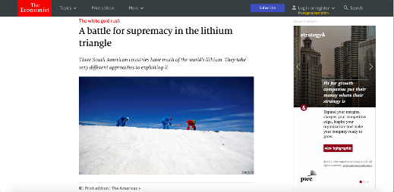
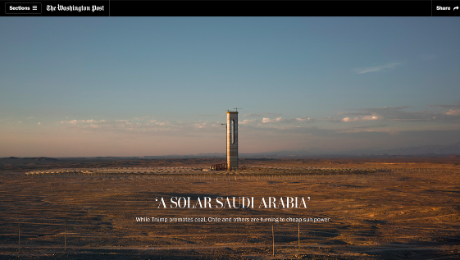
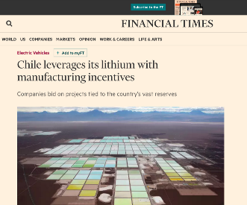
Chile is best positioned to be a leader in the provision of critical minerals like copper, lithium, rare earth and clean fuels according with good environmental, social and governance standards.

