Slide 1
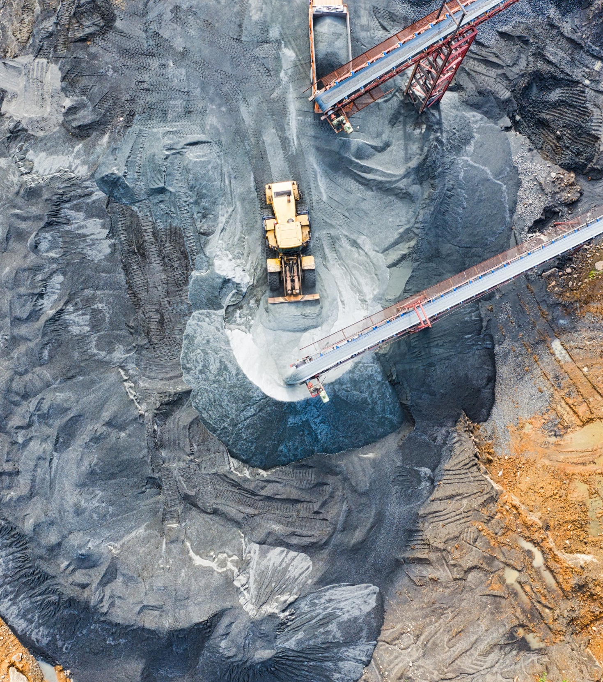
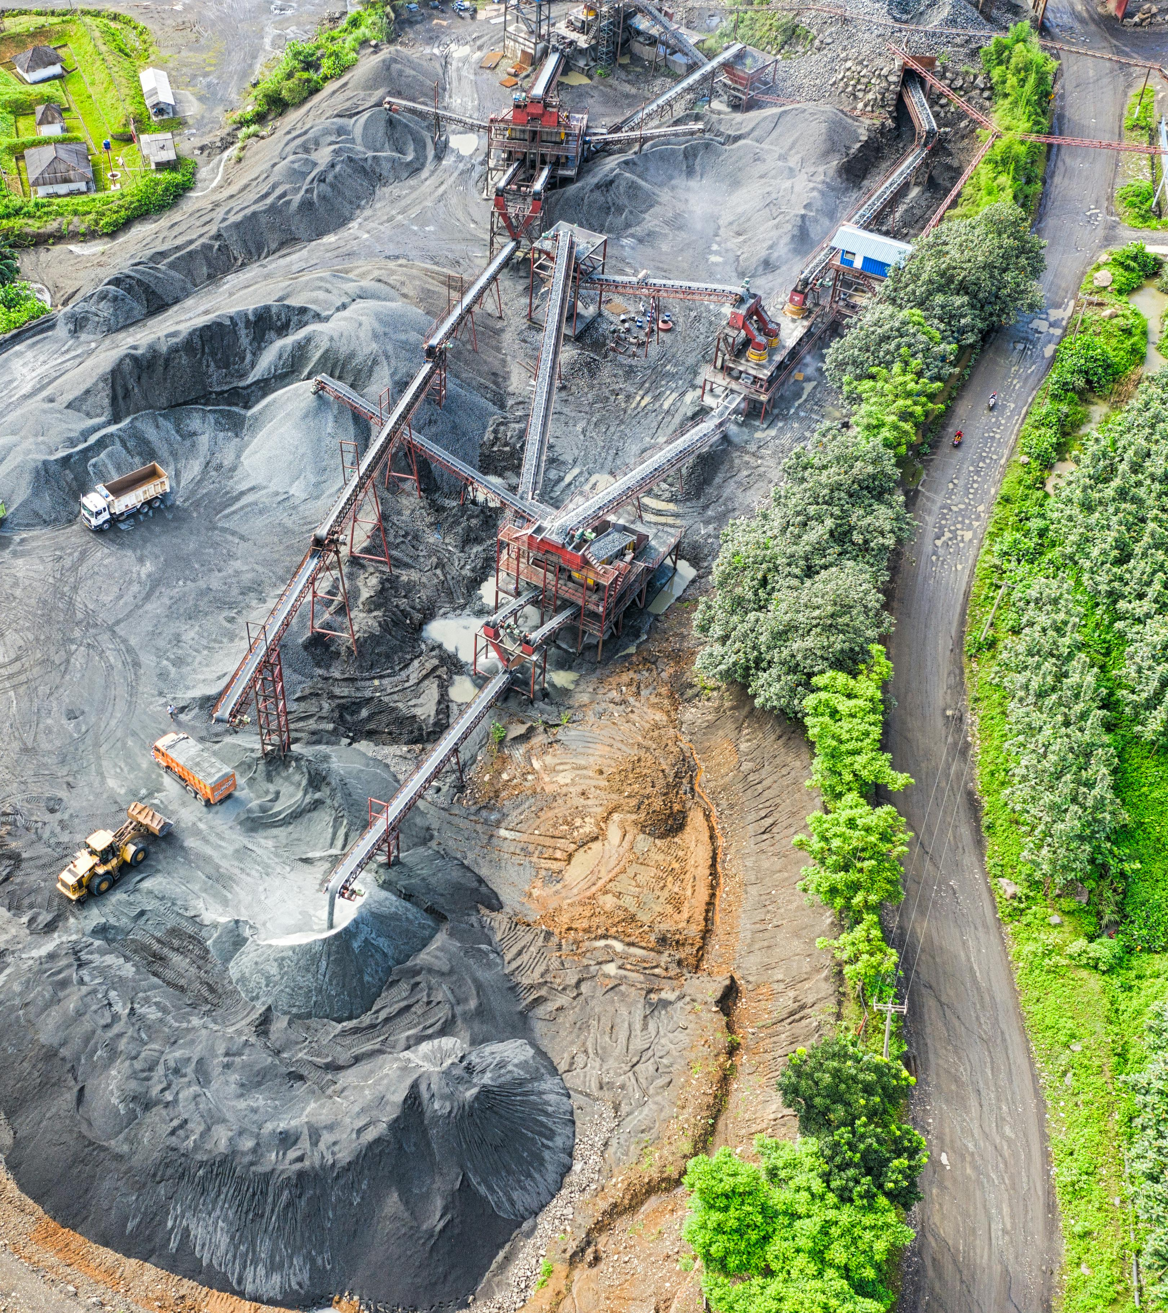
Powering the Future: Digging into Critical Minerals, Supply Chains, and the Energy Transition
Panel 1: The minerals we need, why we need them, and why it matters
Dr. Fabian Villalobos
Engineer, RAND Corporation
Prof. of Policy Analysis, Pardee RAND Graduate School
fvillalo@rand.org

Slide 2
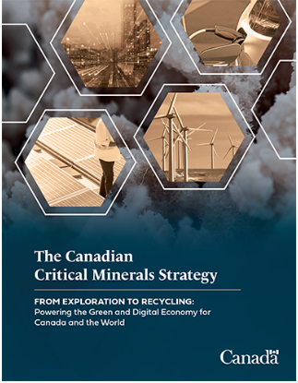
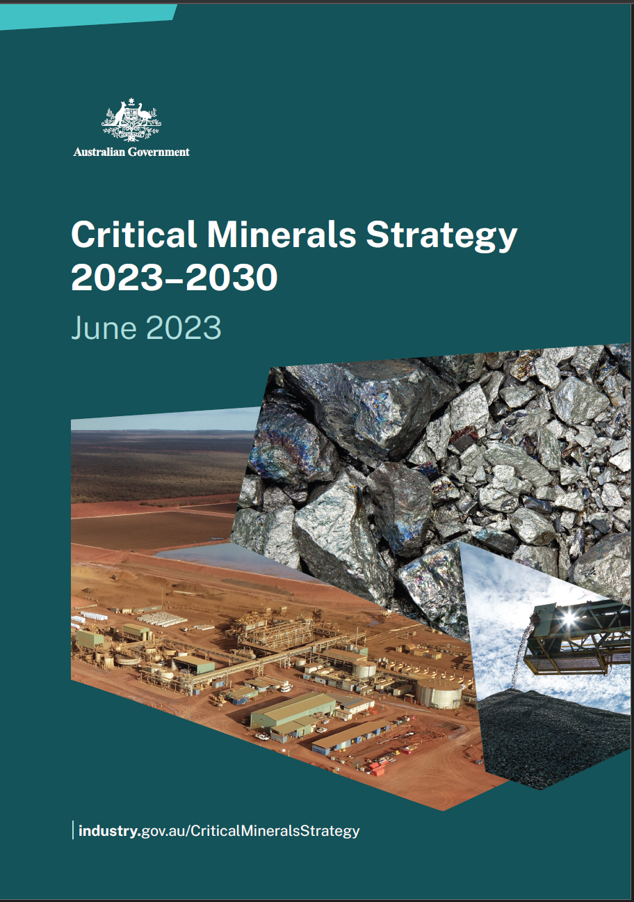
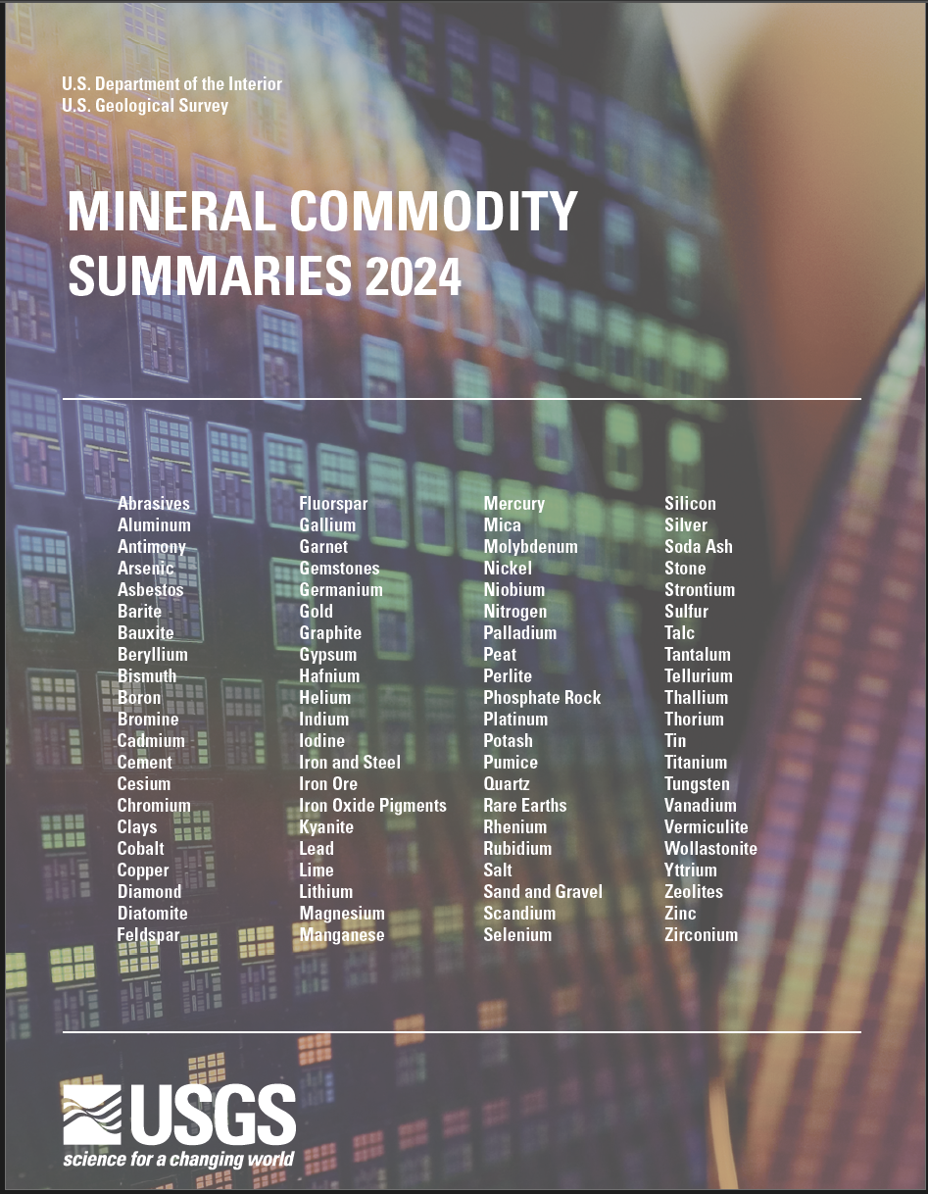
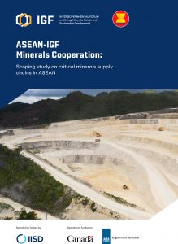

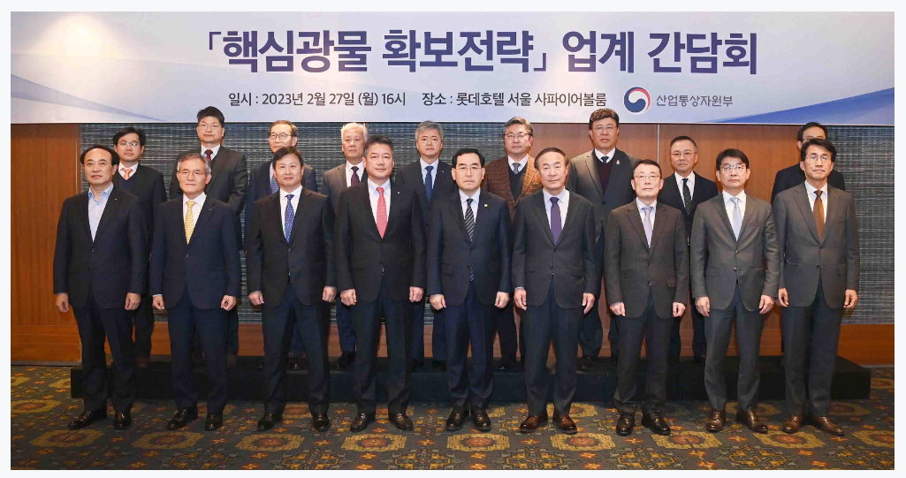
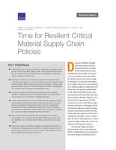



What are Critical Minerals?
The minerals we need
Why we need them
Why it matters

Slide 3
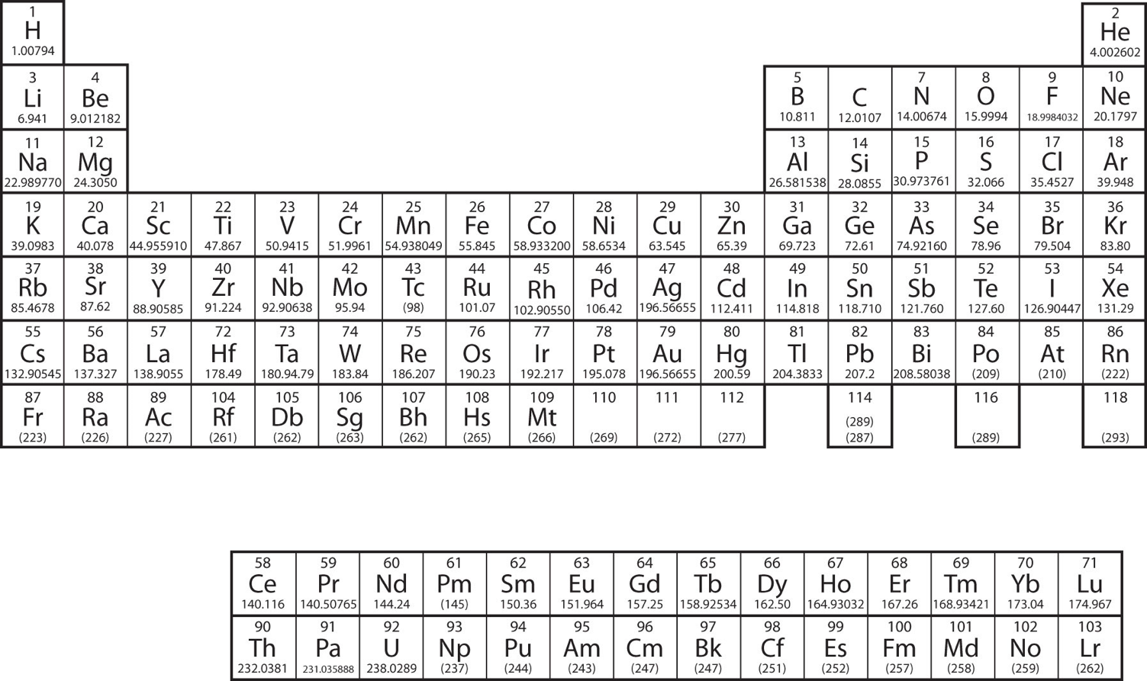
What are Critical Minerals?
The minerals we need
Why we need them
Why it matters
Critical Minerals
Generally: Mineral commodities (and intermediate chemicals) critical to Economic or National Security
Critical Minerals Challenges
High concentration of supply and/or suppliers heightens risk of disruption
  Geographic-, country-, and firm- level concentration
Illiquid Markets
Price volatility
  Deters Investment
Monopolistic + Monopsonistic behavior along with Economic Coercion by market participants
Industries with poor public perception and history
Rare-earth elements
Lithium-Ion Battery inputs
Other Critical Materials
Note: The mineral commodities comprising critical minerals lists are not all pure elements as seen in the periodic table.

Slide 4
What are Critical Minerals?
The minerals we need
Why we need them
Why it matters
Critical Minerals
Generally: Mineral commodities (and intermediate chemicals) critical to Economic or National Security
Critical Minerals Challenges
High concentration of supply and/or suppliers heightens risk of disruption
  Geographic-, country-, and firm- level concentration
Illiquid Markets
Price volatility
  Deters Investment
Monopolistic + Monopsonistic behavior along with Economic Coercion by market participants
Industries with poor public perception and history
Rare-earth elements
Lithium-Ion Battery inputs
Other Critical Materials
Note: The mineral commodities comprising critical minerals lists are not all pure elements as seen in the periodic table.
High uncertainty about access to supply at a fair market price

Slide 5
Why do we care about Supply Chains?
The minerals we need
Why we need them
Why it matters

Slide 6

Why do we care about Supply Chains?
The minerals we need
Why we need them
Why it matters

Slide 7
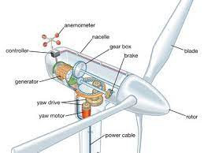
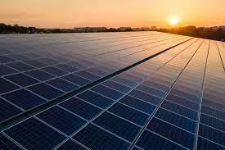



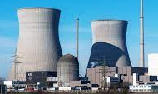


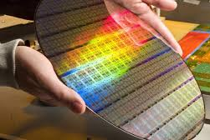
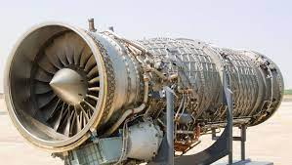

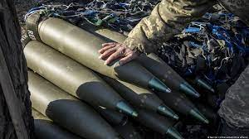

Technology driving demand for Critical Minerals
The minerals we need
Why we need them
Why it matters
Climate, Economic, and National Security concerns underly technological considerations
CLIMATE CHANGE
ECONOMIC
COMPETITIVENESS
NATIONAL
SECURITY

Slide 8
Technology driving demand for Critical Minerals
The minerals we need
Why we need them
Why it matters
Climate, Economic, and National Security concerns underly technological considerations
CLIMATE CHANGE
ECONOMIC
COMPETITIVENESS
NATIONAL
SECURITY

Slide 9
Global Policies Incentivize Investment from Private Sector
The minerals we need
Why we need them
Why it matters
U.S. investing in domestic Li-ion battery supply chain – from mineral extraction to cell mfg
2017 - EO 13817
Directed Dept. of the Interior to publish list of critical minerals (35 materials list); aims to reduce disruption vulnerabilities in supply of critical minerals
2021 - EO 14017
Commences 100-day critical material supply chain review
2022 – Presidential Determination
Mining, beneficiation, processing of critical materials for batteries, EVs, etc. found applicable to Defense Production Act
2022 - Domestic Supply Chain Grants
Uses $2.3B from BIB to develop domestic extraction and recycling capacity for battery supply chain
2020 - EO 13953
Declares national emergency from material dependence on foreign adversaries; directs all agencies to investigate dependencies and prioritize expanding domestic mineral production
2021 - Bipartisan Infrastructure Bill
Allocated $7B of funding to build a domestic battery supply chain and EV charging infrastructure
2022 - Inflation Reduction Act
Mandates domestic sourcing of raw materials and cell production for EVs; effectively bans raw materials from China or Russia…
SOURCE: Federal Register, National Archives

Slide 10
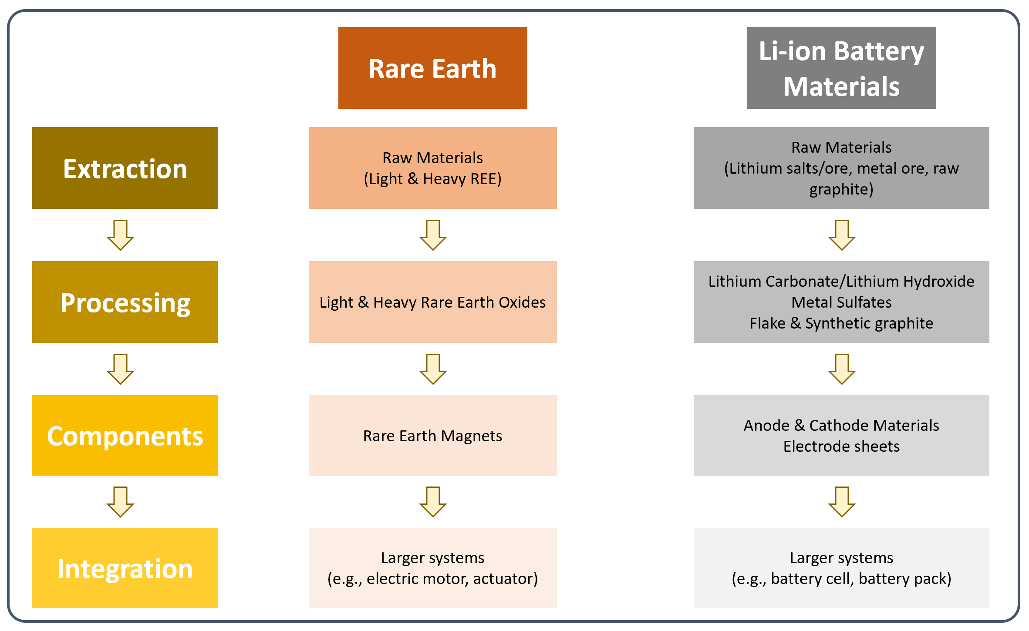
What is a Critical Mineral Supply Chain (CMSC)?
The minerals we need
Why we need them
Why it matters
Generally, 4 parts of a CMSC:
  Extraction, Processing, Component Manufacturing, Systems Integration
Risks inherent in CMSCs
  Lack of supply chain diversity, higher risk for countries with little domestic capacity
  Constraints in any of these sectors could be a point of origin for shocks and disruption of supply or prices
  Generally, most constraints in extraction and processing nodes
  Shocks and disruption could affect a country’s broader economy, the ability of the commercial and/or defense industrial base to procure materials inputs and manufacture products
Notional Supply Chain Dependent on Critical Materials Processing and Extraction
Villalobos, Fabian, Jonathan L. Brosmer, Richard Silberglitt, Justin M. Lee, and Aimee E. Curtright, Time for Resilient Critical Material Supply Chain Policies. Santa Monica, CA: RAND Corporation, 2022. https://www.rand.org/pubs/research_reports/RRA2102-1.html.

Slide 11
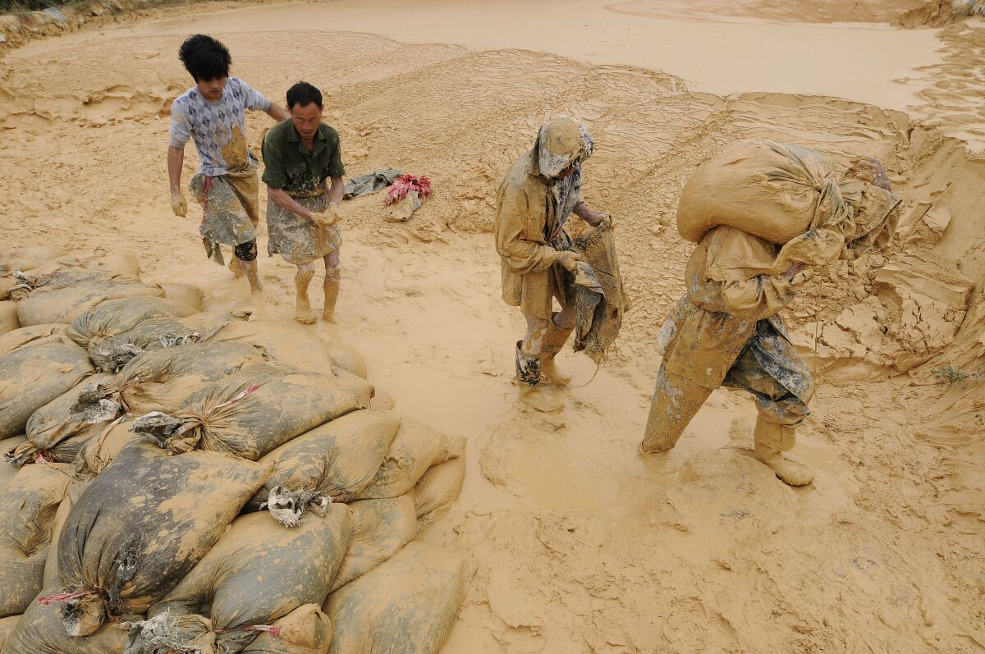
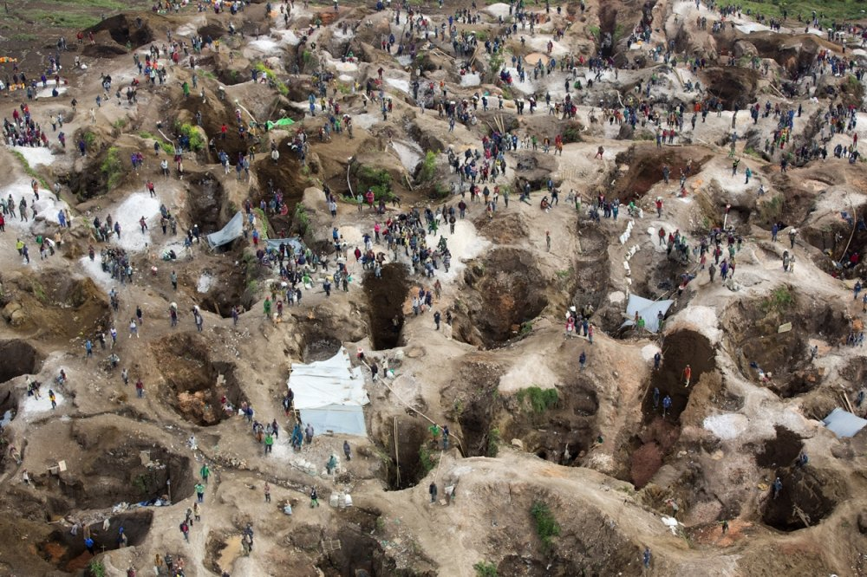
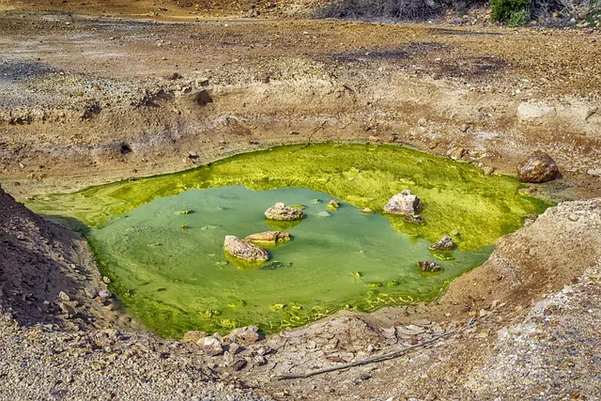
Concerns from increased demand for Critical Minerals
The minerals we need
Why we need them
Why it matters
Environmental and Social impacts from Extraction and Processing of Critical Minerals

Slide 12
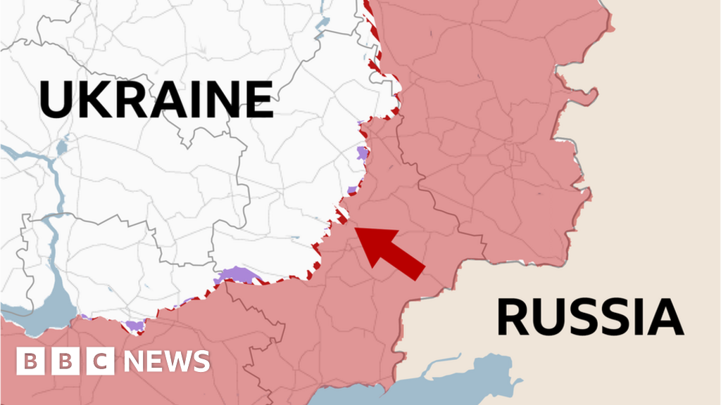
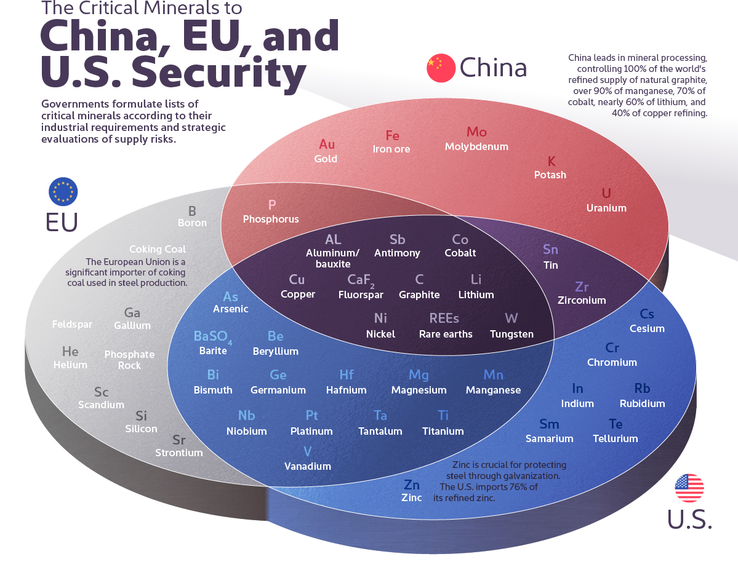
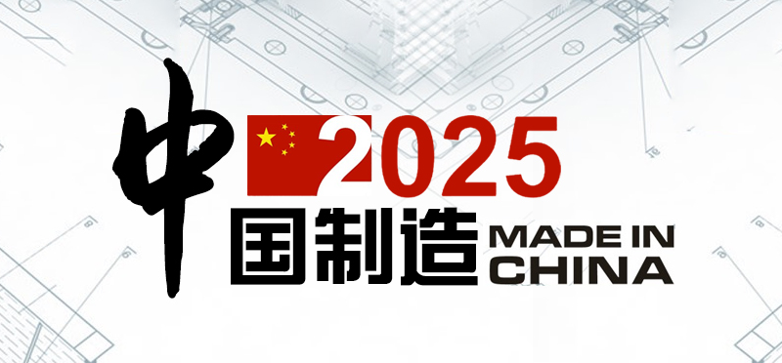
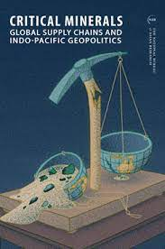


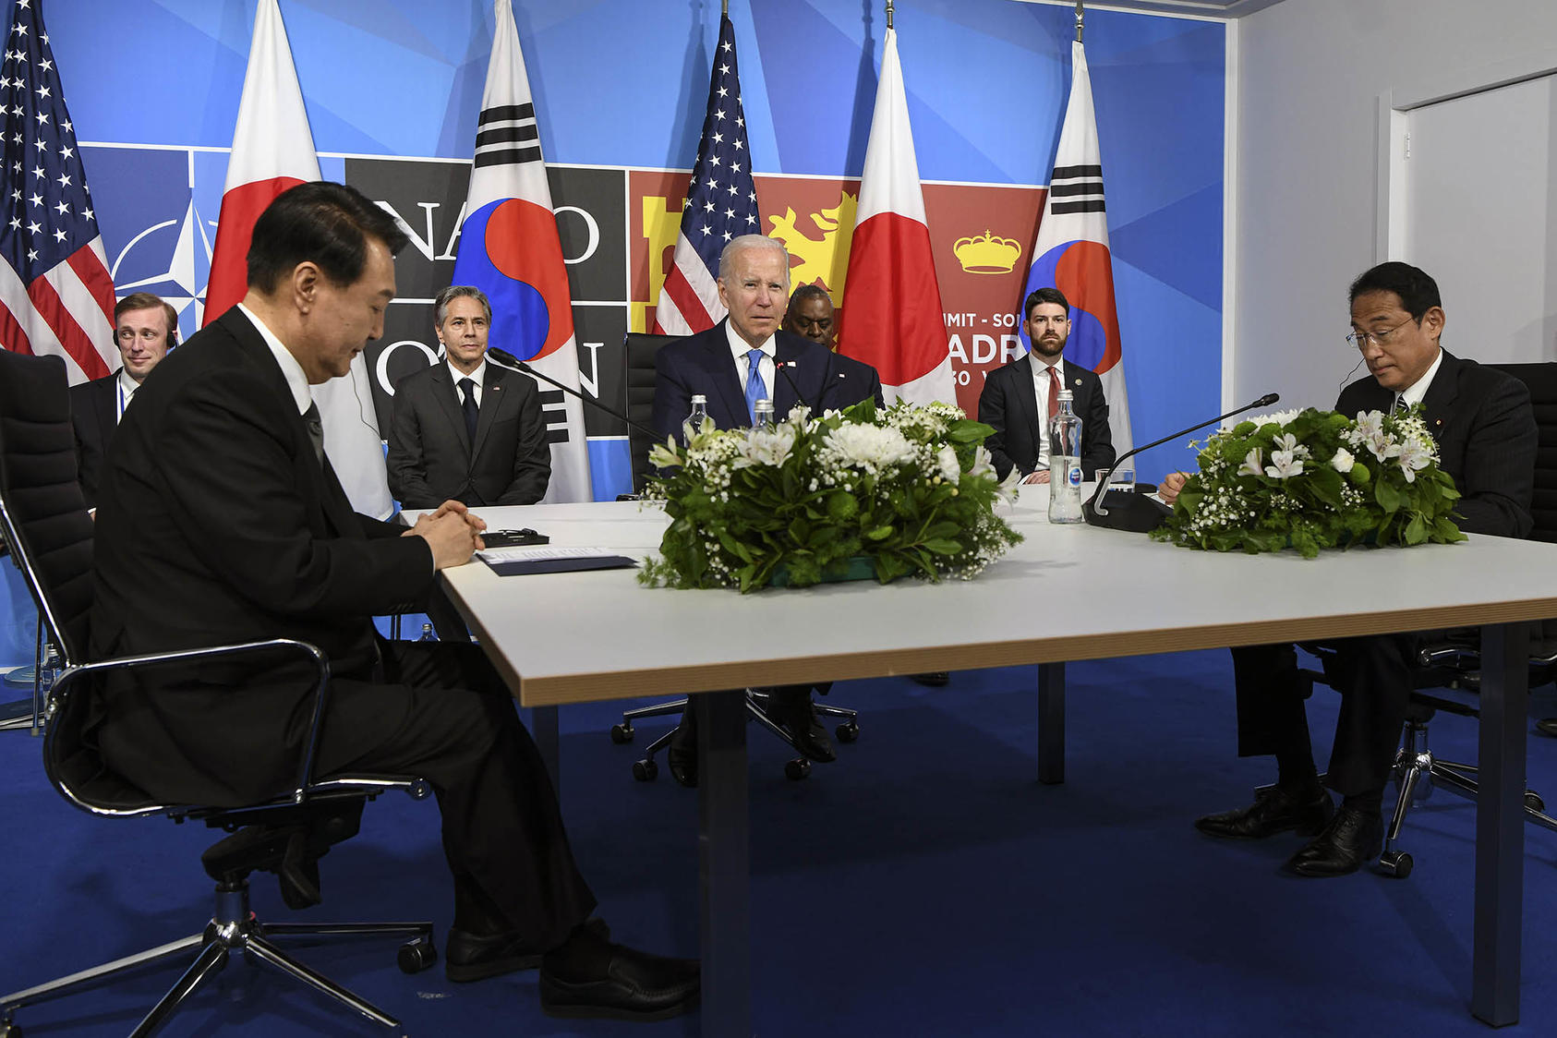

Concerns from increased demand for Critical Minerals
The minerals we need
Why we need them
Why it matters
Geopolitical, Economic, and Technological Competition
(Kenny Holston/The New York Times)
IRENA (2023), Geopolitics of the energy transition: Critical materials, International Renewable Energy Agency, Abu Dhabi.

Slide 13

Concerns, Yes. But Also, Opportunity.
The minerals we need
Why we need them
Why it matters
https://odi.org/en/about/our-work/climate-and-sustainability/faq-2-oil-and-gas-poverty-and-economic-development/

Slide 14
Thank You!
Dr. Fabian Villalobos
Engineer, RAND Corporation
Prof. of Policy Analysis, Pardee RAND Graduate School
fvillalo@rand.org

